Slide 1

Who do Americans Spend their Lifetime with?
…by age
Prepared by:
Diksha Manwani

Slide 2
About the Dataset
Source: Our World in Data
The Data shows the amount of time people in the US report spending in the company of others, based on their age.
It comes from time-use surveys, where people are asked to list all the activities they perform over a full day and the people who were there during each activity.
The numbers are based on averages for a cross-section of the American society, and the average amount of time that survey respondents of different ages report spending with other people changes over the course of life.

Slide 3
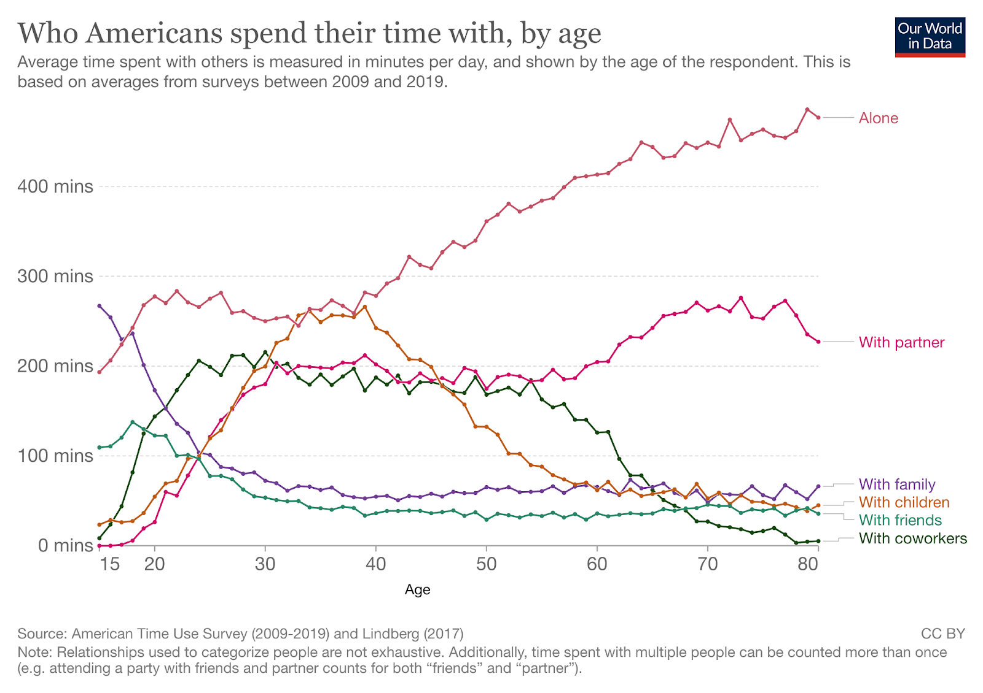
Original Visualization

Slide 4
Feedback from 'Watch Me Viz'
Andy Kriebel absolutely loved this visualization.
He had nothing against it and in the entire video, he tried to recreate the same visualization to the T.
He tried to replicate even the fonts, captions, and colors! He came pretty close.

Slide 5
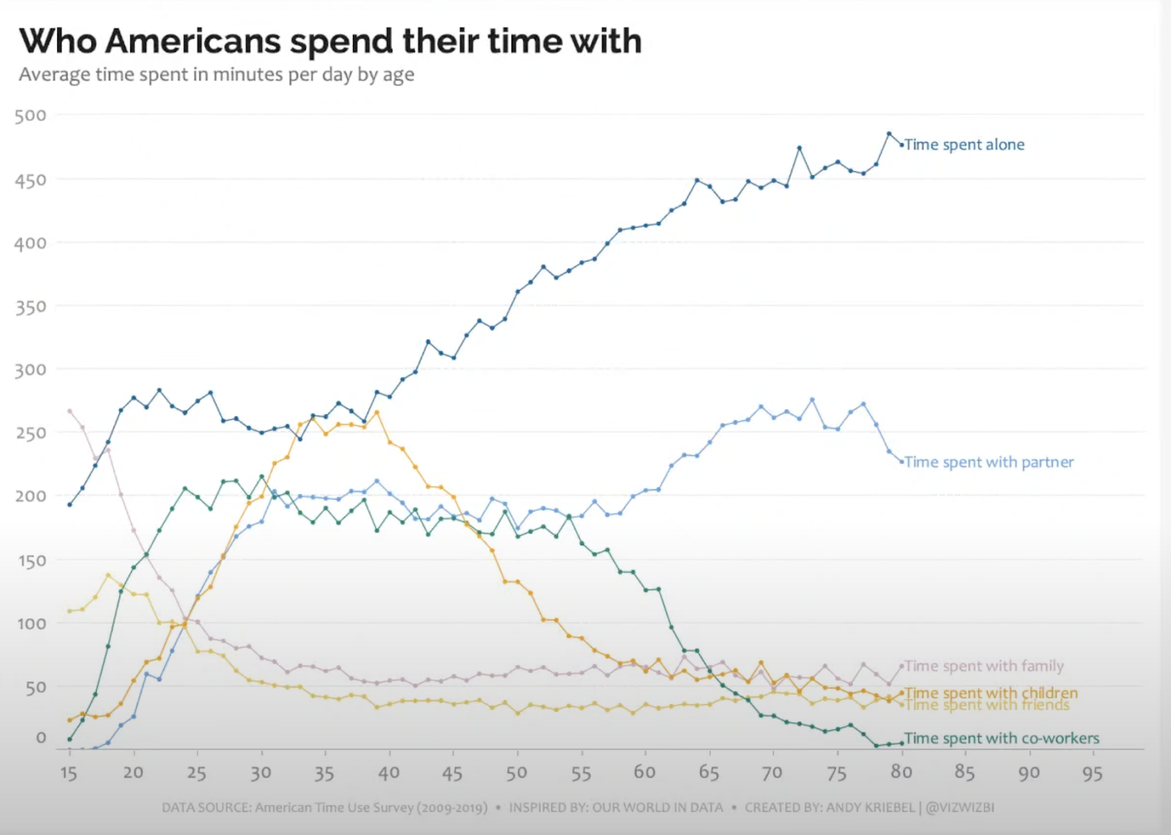
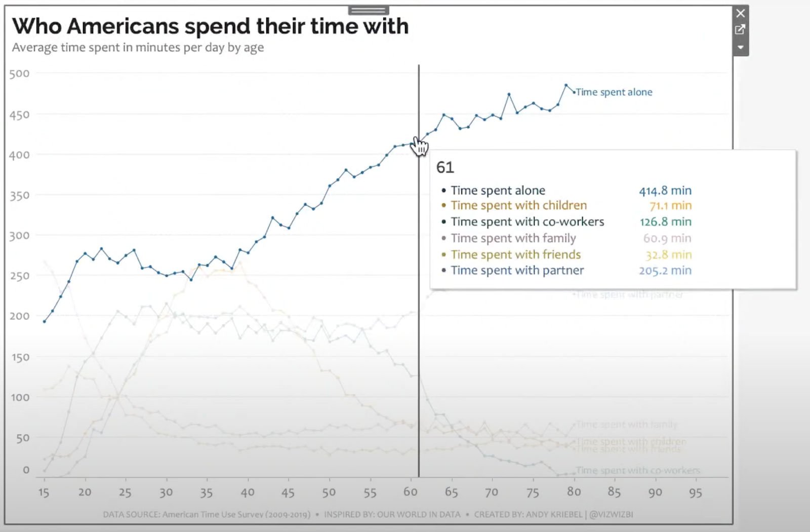
Andy’s Recreated Visualization

Slide 6
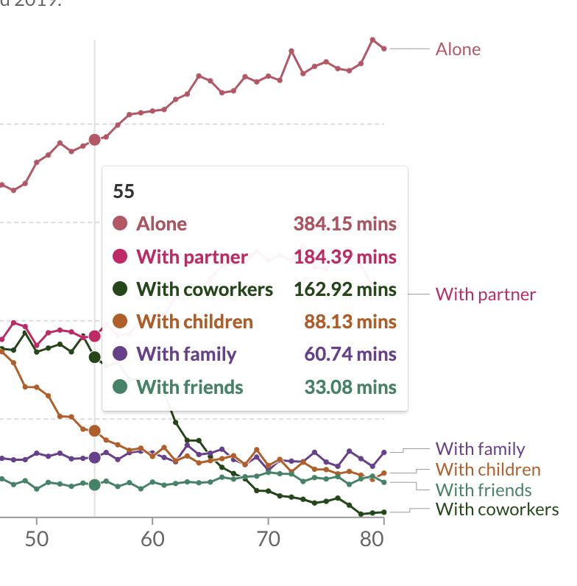
Some Interesting Techniques used
There were a lot of fascinating new things used in the visualization like the customized tooltip.
Even Andy struggled with it a little in the beginning. As we can see, the tooltip is color coded with a dot at the beginning which is not the default pattern of a tooltip.
Andy created a separate worksheet and creates columns of categories like ‘Alone’, ‘With Partner’, etc., and the average time spent. Then he uses this worksheet to create the tooltip.

Slide 7
Some Interesting Techniques used
Also, we can see there is a dynamic vertical line right next to the tooltip.
The way Andy tried to achieve this was to use a reference line with a parameter. This was towards the end, and he did it only for the Alone category. It didn’t turn out exactly like the original but did the trick.

Slide 8
Feedback from ‘Viz Review’
Eva Murray has provided valuable feedback on various visualizations of the same dataset. Some key points highlighted by her include
Improving the title by turning it into a relevant question and specifying whether it pertains to Americans in the US or worldwide.
It is also recommended to include a brief description of the dataset, fix the axes, and provide a bullet list of who Americans spend time with to answer the question at hand.
For an animated chart, Eva recommends adding a play button and improving the call to action for a generational comparison chart.
To enhance the clarity of the data, Eva suggests incorporating a narration to explain the pattern that emerges in the data and providing more information about the individuals who spend the most time alone. Furthermore, it is advised to add more white space, fix the axes, clarify the labels, and make colors more distinct to increase the overall conciseness of the visualizations.

Slide 9
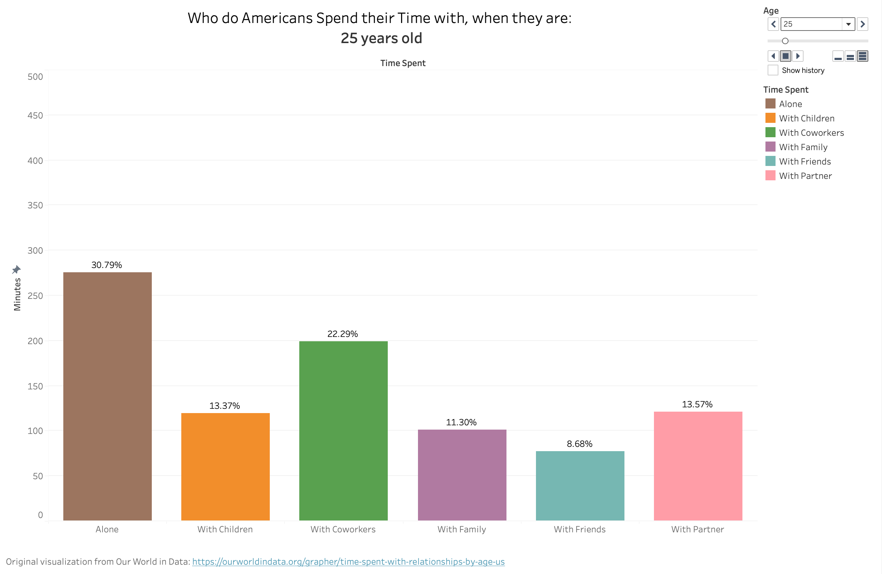
My take on this Visualization

Slide 10
Reasons behind my Visualization
I made a visualization which is completely different from the original one. Despite creating a unique and impressive visualization, it took me some time to comprehend its intended message. Therefore, I aimed to simplify the interpretation process for viewers.
In my opinion, Dynamic Visualization effectively presents the development of events over time, and that's why I selected it as my preferred method of demonstration.
I specifically opted for Dynamic Bar Graphs due to their straightforwardness, aesthetic appeal, and ability to clearly exhibit alterations.

Slide 11
Reasons behind my Visualization
Based on the reviews, I incorporated the page name into the title to enable viewers to identify the age group that the data pertains to.
I also added the Percentage of minutes as Label, because it’s much easier to interpret. Also, this is one thing that could’ve been there in the original visualization instead of Number of Minutes.
I’ve tried to keep the visualization simple and clean, while conveying the information.
Also, in the dashboard, I added a caption in the end. Just something I thought was cool.

Slide 12
Thank You!

